Slide 1

HMS Automated Retrospective Review
Recovery Audit Automated Review Process
HMS a Gainwell Company Confidential. Do not distribute.

Slide 2
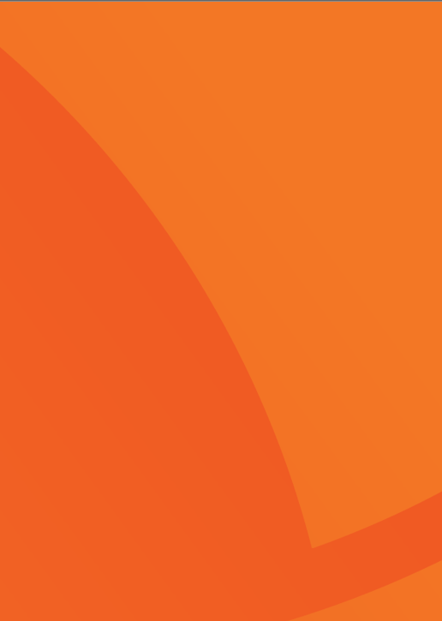

Purpose
1
Understanding the Review
Provide an overview of the Recovery Audit Contract for Colorado.
2
Understanding the Review Process
Provide an overview of our review process.
Collaboration and Communication
Ensure your questions and concerns are addressed, and you have HMS’ contact information for questions and support.
3
HMS a Gainwell Company Confidential. Do not distribute.

Slide 3

▪Medicare Modernization Act of 2003 created a
demonstration project to identify Medicare
Overpayments
• Operational from 2005 through 2007
• Made permanent in 2008
▪Section 6411(a) of the Affordable Care Act
expanded RAC to Medicaid.
• Identification of improper payments
• Coordination of audit efforts with state audit efforts
• Education to providers
▪Colorado Revised Statutes (CRS)
• CRS Section 25.5-4-301
▪Code of Colorado Regulations (CCR)
• 10 CCR 2505-10
• Section 8.015.8B
• Section 8.076.2-3
• Section 8.130.2A
Background on the Recovery Audit Contractor

Slide 4
Automated
Review
HMS a Gainwell Company confidential. Do not Distribute.

Slide 5

Automated Review
  Our Payment Analytics uses data analysis queries and algorithms to compare claims history against specific billing, coding, utilization and reimbursement rules that client systems or claim processors might miss. Payment Analytics leverages analytics and algorithmic variation to isolate claim overpayments for
  data-driven, rules-based adjudication.
Automated Reviews are used when improper payments can be identified clearly and unambiguously using paid claims data.
Examples:
  Services rendered after date of death
  Services rendered to recipients no longer eligible for Health First Colorado
  Duplicate payments
  Demographic

Slide 6
Review Process
The Department reviews and approves all letter and determinations made by HMS before anything is finalized.
Potential overpayment scenarios are researched and developed by HMS. If a scenario proves to identify potential overpayments it is thoroughly reviewed by the Department and approved or denied by the Department. If denied or no overpayments are found, the scenario is closed internally with HMS.
Once the Department approves a scenario HMS prepares its findings for the Department to review. If the Department approves the findings, a notice of adverse action is mailed via Certified Mail and posted in the Portal. If the Department doesn’t approve, the findings are closed within HMS system.
After provider receives a notice of adverse action the provider can agree with the findings, request an Informal Reconsideration (IR) or file an Appeal. If the provider agrees or the findings have been upheld through the IR/Appeal process the findings are recovered by the Department.
The findings from this analysis are reported to Health First Colorado, along with recommendations
regarding proper payment of the claim.
HMS a Gainwell Company Confidential. Do not distribute.

Slide 7
Determination Letters
Notice of Adverse Action, Overpayment Determination letter
  Indicates that a claim review resulted in a finding of inaccurate billing.
  The packet contains two documents:
01
    Cover
    letter
      Instructions for next steps and requesting an informal reconsideration or appeal.
02
      An audit detail with an explanation of the review rationale and a listing of all claims that were included the HMS findings.
    Audit Detail
HMS a Gainwell Company Confidential. Do not Distribute.

Slide 8
Informal Reconsiderations and Appeals
HMS a Gainwell Company Confidential. Do not distribute.

Slide 9

Informal Reconsideration
Under Health First Colorado’s Medicaid Program, Providers have the right to file an Informal Reconsideration that must be received by HMS within 30 days of letter date on Notice of Adverse Action, Overpayment Determination letter.
Providers should be specific about what they disagree with regarding HMS findings and include any documentation that may support their position.
Providers should receive a confirmation call from HMS Provider Services when an Informal Reconsideration request has been received for their claim(s).
HMS a Gainwell Company Confidential. Do not distribute.

Slide 10
Informal Reconsideration
Providers will receive a consolidated letter with the outcome of their Informal Reconsideration requests within 45 days after HMS receives the request. Your letter will include claims that were overturned and/or upheld as referenced below.
Informal Reconsideration Overturn Letter
  Review of additional documentation identifies no findings of improper billing.
  Claims are substantiated and HMS concurs with the documentation.
  No further action needed.
Informal Reconsideration Uphold Letter
  Review of additional documentation concludes that initial determination was accurate.
  Documentation did not substantiate the services billed.
Combination of Both
  A list identifying claims that are Overturned
  One page for each claim/line that is Upheld
HMS a Gainwell Company Confidential. Do not distribute.

Slide 11

Appeals
Information regarding filing an appeal will be in the Notice of Adverse Action letter.
Must be received by Office of Administrative Courts within 30 days of the Notice of Adverse Action, Overpayment Determination letter or Informal Reconsideration determination letter being sent.
Informal Reconsiderations are not needed before appeal is submitted; however, it is highly encouraged by the Department that providers utilize their rights and get a chance to refute any findings they disagree with and have that documented.
Once an appeal is received all communication regarding that case will be routed through the State Attorney Generals office. HMS Provider Services and the Department will be unable to discuss a case in active litigation.

Slide 12


Review Timing
Automated Review
Agree – 30 days from the date of the Demand Letter to return overpayment to the Department
Disagree– 30 days from date of the Notice of Adverse Action to submit Informal Reconsideration Request
Disagree– 30 days from date of the Notice of Adverse Action or Informal Reconsideration response to file appeal to Office of Administrative Courts

Slide 13
Provider Portal

Slide 14
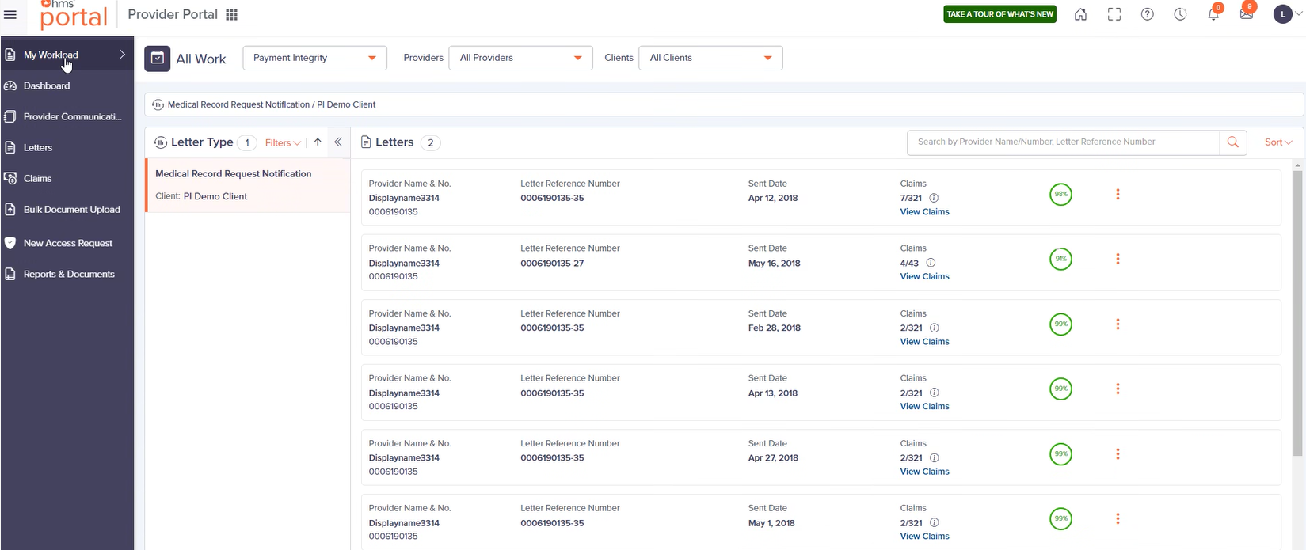
Provider Portal My Workload
This screen provides information for claims that are still open. This is the easiest way to navigate open claims.
HMS a Gainwell Company Confidential. Do not distribute.

Slide 15
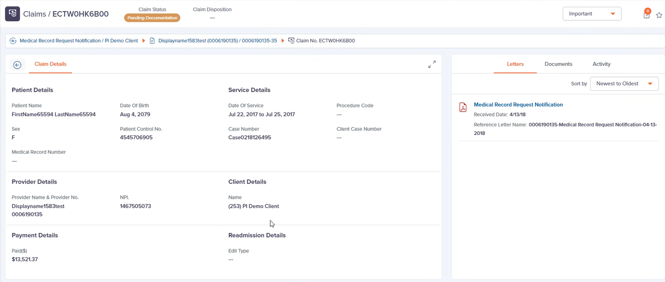
View Specific Claims
Claims- When a specific claim is selected the detail to the claim will be displayed. Information such as Patient Name, Date of Birth, Sex, Patient Control No., Date of Service, Case Number and Provider details, will all display on this screen.
HMS a Gainwell Company Confidential. Do not distribute.

Slide 16
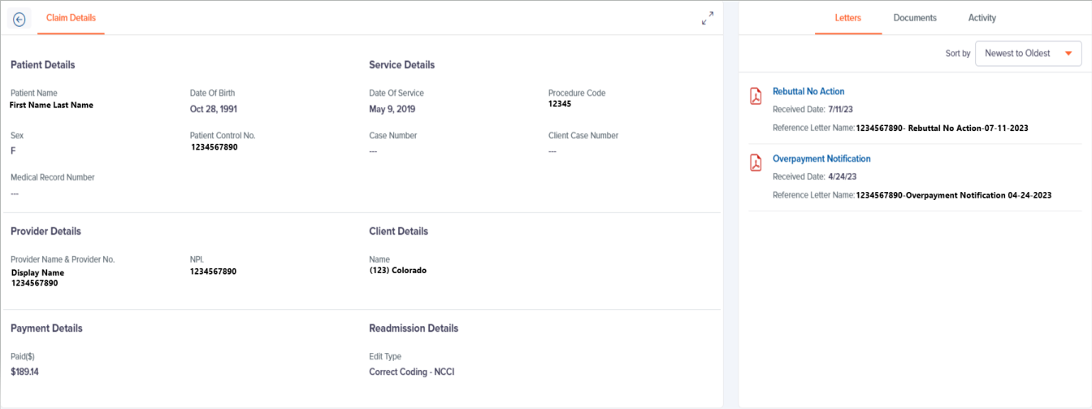
View Specific Claims
Letters-On the right side of the screen, under the Letters tab, any letters that have been mailed on this claim can be reviewed.
HMS a Gainwell Company Confidential. Do not distribute.

Slide 17
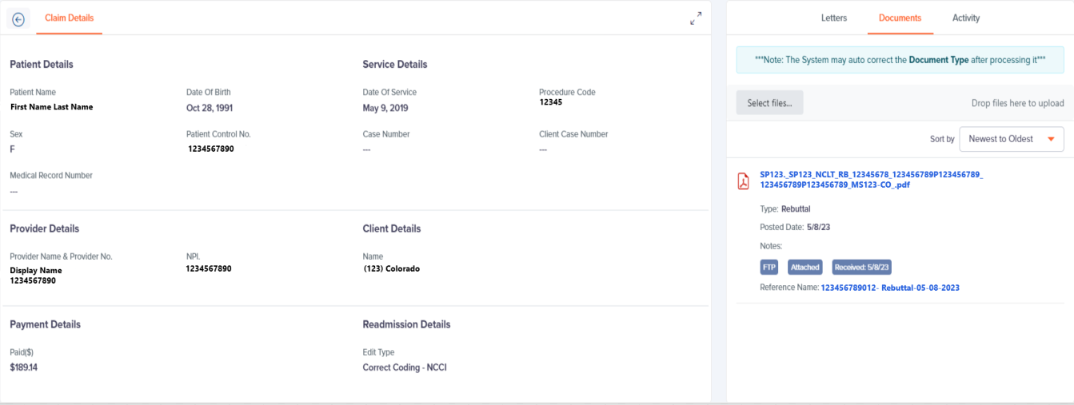
Attach and View Documents
Attach documents to the specific claim and view any documents already attached.
HMS a Gainwell Company Confidential. Do not distribute.
Notes:
Under the documents tab, you can submit documents for informal reconsideration in PDF format. For medical records request, you will upload documents that are specific to that claim. If you are uploading documents for an automated claim, you can upload the document to one claim in the Case, and can then call our provider services to have it attached to the entire Case. If you tried to upload a document but do not see it under the documents tab, it was not effectively uploaded so you will need to upload to change the claim activity.

Slide 18
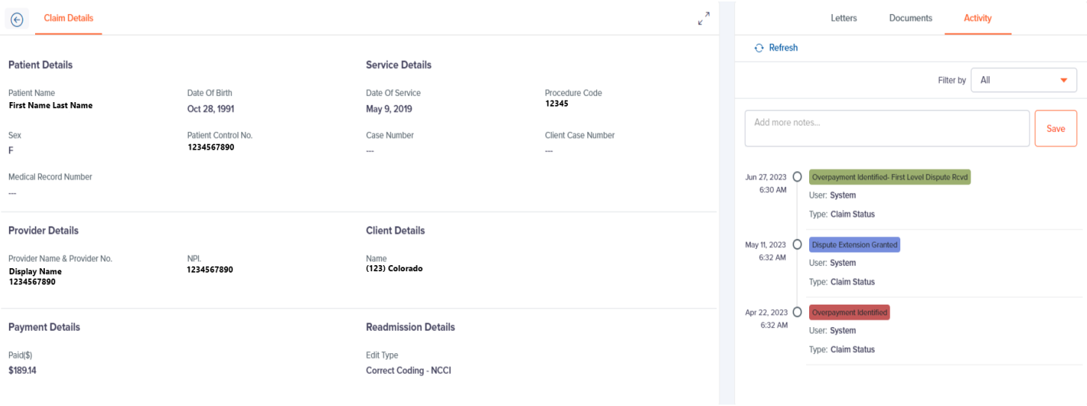
Claim Activity
View the current status of the claim, has it moved to IR, Upheld etc.
HMS a Gainwell Company Confidential. Do not distribute.
Notes:
On the activity tab you can see the activity of the claim. This is a great place to check and make sure the claim has been moved to an informal reconsideration. If you see that the activity has not changed, again I would go back to the documents tab and make sure that your files uploaded to the claim.

Slide 19
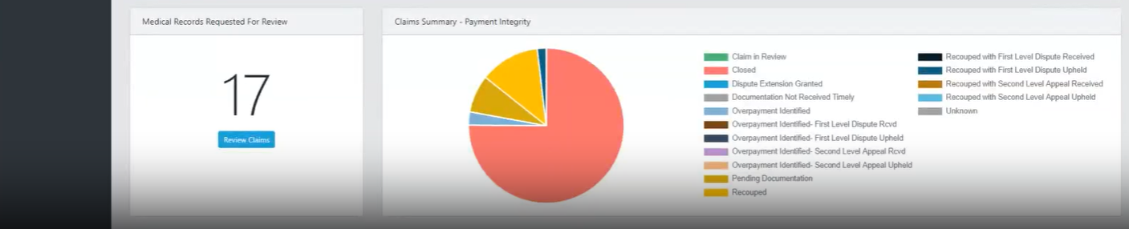
Manage Claims for Multiple Facilities
Access to Multiple facilities- Use dropdown to select the facility you would like to select claims for.
Review Claims- The dashboard captures all the audits HMS has ever done for the facility selected.
Medical Records Requested for Review- This index card displays the number of claims that are outstanding and need medical records. These claims are also referenced under Claims Summary as Pending Documentation. (not applicable for automated)
HMS a Gainwell Company Confidential. Do not distribute.

Slide 20
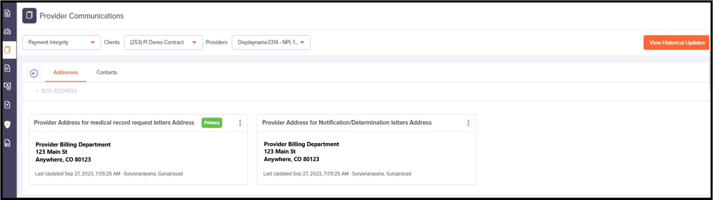
Update Address Information
Addresses and Contact- Allows providers to update the mailing and contact information +ADD ADDRESS.
Updating Addresses - When updating the addresses, providers should only utilize 2 Address Types:
  Provider Address for medical record request letters Address- All medical record requests will be mailed to the address provided under this Address Type
  Provider Address for Notification/Determination letters Address- All notifications such as findings and appeal determinations will be mailed to the address provided under this Address Type.
HMS a Gainwell Company Confidential. Do not distribute.

Slide 21
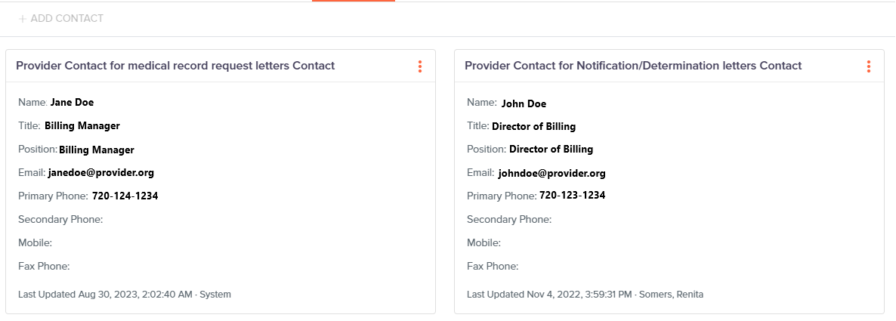
Update Contact Information
Contacts- Allows providers to update the Contact information by using + ADD Contact.
Updating Contacts- The contact information will be used by the Provider Relations Team when they are doing their courtesy call outs. Providers should only utilize 2 Contact Types:
  Provider Contact for medical record request letters Contact- All medical record requests will be mailed to the address provided under this Address Type
  Provider Contact for Notification/Determination letters Contact- All notifications such as findings and appeal determinations will be mailed to the address provided under this Contact Type.
HMS a Gainwell Company Confidential. Do not distribute.

Slide 22
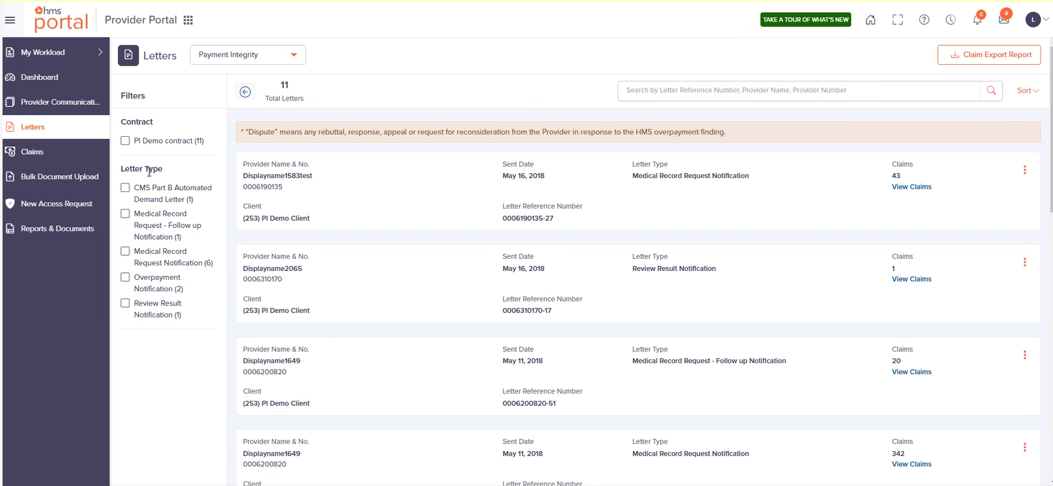
Letters
Letters- Access all letter that have been sent out. Claims can also be exported using Claim Export Report function.
HMS a Gainwell Company Confidential. Do not distribute.

Slide 23




Additional Provider Portal- Resources
FAQ- Review answers to commonly asked questions regarding the use of the portal.
Explore HMS- Takes you to HMS homepage where you can learn more about HMS.
Training- Watch training that will help with navigating and utilizing all benefits the portal has to offer.
HMS Newsroom- Keep up to date on news articles that will help you get to know HMS better
HMS a Gainwell Company Confidential. Do not distribute.

Slide 24
Provider Services
HMS a Gainwell Company Confidential. Do not distribute.

Slide 25

HMS encourages providers to contact us with their concerns and questions
We view our one-to-one discussions as ideal opportunities to provide education, answer any questions and alleviate concerns
Our Provider Relations team stands ready to guide you throughout the entire process
Open Communication
HMS a Gainwell Company Confidential. Do not distribute.

Slide 26
Provider Support
HMS Provider Services Line
(877) 640-3419
Letter
inquiries
Process questions
Claim status verification
Monday through Friday
8 a.m. to 5:00 p.m. MST
Provider Education Website: https://resources.hms.com/state/colorado/rac
HMS a Gainwell Company Confidential. Do not Distribute.

Slide 27
Thank you for attending and we look forward to working together.
For Additional information regarding our Clinical Claims Review process, please visit
https://resources.hms.com/state/colorado/rac

Slide 28


Moving healthcare forward.
hms.com
© 2020 HMS. All rights reserved.
Alyssa Gilger- Recovery Audit Contract Section Manager
Tara Wingo- HMS Program Director
Alyssa.Gilger@state.co.us
Tara.Wingo@hms.com
Chantal Kalisch- HMS Senior Program Manager
Lorena Sarate- HMS Program Manager
Chantal.Kalisch@hms.com
Lorena.Sarate@hms.com

